Slide 1
Volume Control With Hand Detection

Slide 2
TEAM MEMBERS :
LVR DHEERAJ – RA1911033010092
RAKESH NARAPAREDDY - RA1911033010079

Slide 3
ABSTARCT :
The Volume Control With Hand Detection OpenCV Python was developed using Python OpenCV, In this Python OpenCV Project we are going Building a Volume Controller with OpenCV , To change the volume of a computer.
Gesture recognition helps computers to understand human body language. This helps to build a more potent link between humans and machines, rather than just the basic text user interfaces or graphical user interfaces (GUIs). In this project for gesture recognition, the human body’s motions are read by computer camera.

Slide 4
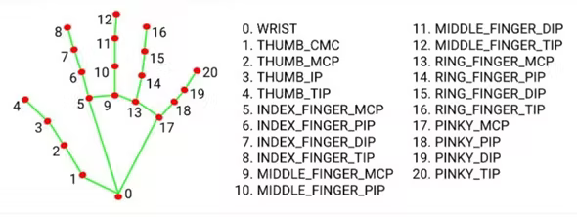
OBJECTIVE :
The objective of this project is to develop an interface which will capture human hand gesture dynamically and will control the volume level. For this, Deep Learning techniques such as Yolo model, Inception Net model+ LSTM, 3-D CNN+LSTM and Time Distributed CNN+LSTM have been studied to compare the results of hand detection.

Slide 5
ISSUES IN EXISTING PROJECT :
Can't be used for long distance
Sometimes not accurate
Requires a decent camera
May be confused by two palms

Slide 6
PROPOSED METHODOLOGY :
Detect hand landmarks
Calculate the distance between thumb tip and index finger tip.
Map the distance of thumb tip and index finger tip with volume range. For my case, distance between thumb tip and index finger tip was within the range of 30 – 350 and the volume range was from -63.5 – 0.0.
In order to exit press ‘Spacebar'.

Slide 7
System Flow Diagram :
Capture
Object detection
Hand detection
Gesture control
Feature extraction

Slide 8
WORKING PRINCIPLE :
The camera in our device is used for this project. It detects our hand with points in it so as it can see the distance between our thumb fingertip and index finger tip. The distance between the points 4 and 8 is directly proportional to the volume of device.

Slide 9
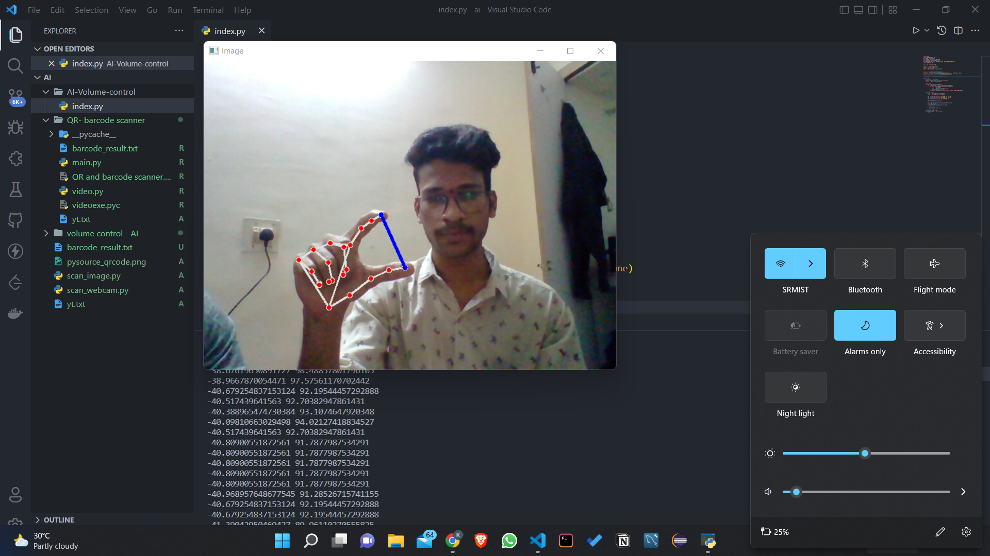

SCREENSHOTS :

Slide 10
CONCLUSION :
Gesture recognition helps computers to understand human body language. This helps to build a more potent link between humans and machines, rather than just the basic text user interfaces or graphical user interfaces (GUIs).
In this project for gesture recognition, the human body’s motions are read by computer camera. The computer then makes use of this data as input to handle applications.

